Slide 1
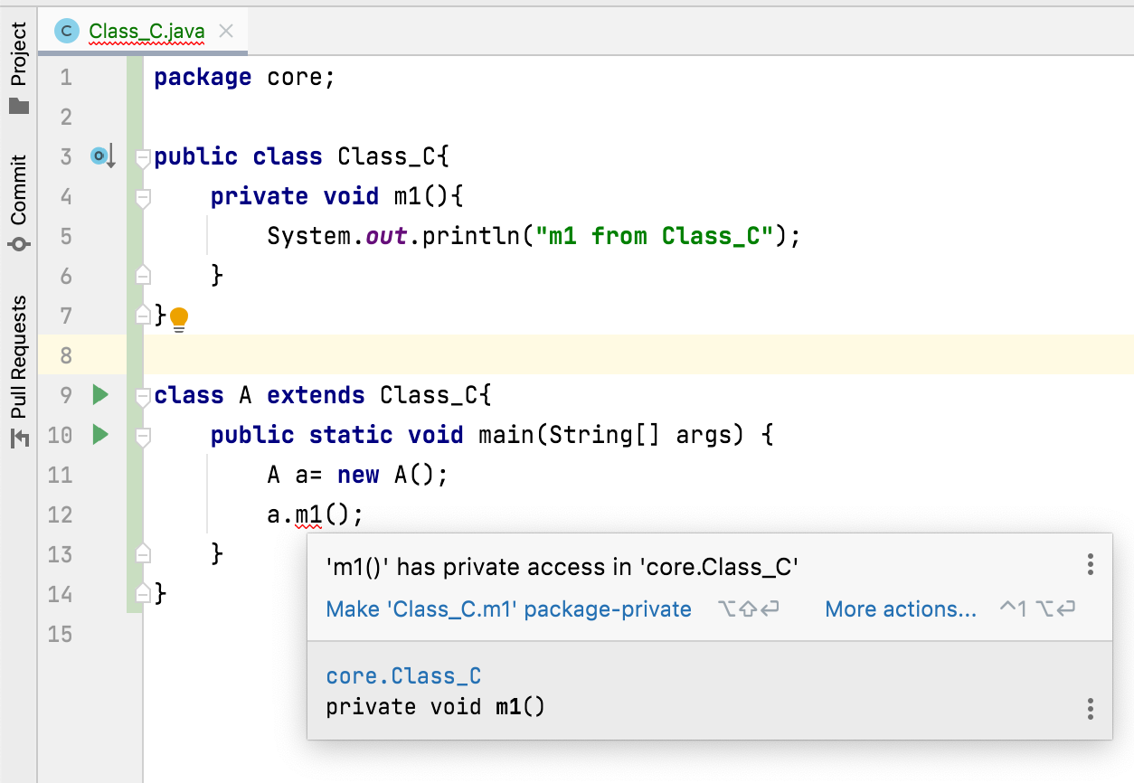
How to restrict a member of a class from inheriting to its sub classes?
By declaring that member as a private.
Because private members are not inherited to sub classes.

